Slide 1
Physical Ergonomics:
Anthropometry
Work Systems and the Methods, Measurement, and Management of Work
by Mikell P. Groover, ISBN 0-13-140650-7.
©2007 Pearson Education, Inc., Upper Saddle River, NJ. All rights reserved.

Slide 2
Definition of Anthropometry
The part of anthropology (study of humans) having to do with measurements of the human body to determine differences in races, individuals, etc…
Source : Webster’s New 20th Century Dictionary (1970)
Anthropometry is a science that deals with the measurement of size, weight, and proportions of the human body. It is empirical (experimentally derived) in nature and has developed quantitative methods to measure various physical dimensions. (Chaffin, 1984)
Work Systems and the Methods, Measurement, and Management of Work
by Mikell P. Groover, ISBN 0-13-140650-7.
©2007 Pearson Education, Inc., Upper Saddle River, NJ. All rights reserved.

Slide 3
Anthropometry
Empirical science concerned with the physical measurements of the human body, such as height, range of joint movements, and weight
Derived from the Greek words anthropos (man) and metron (to measure)
Usually considered a branch of anthropology
Strength characteristics also sometimes included in the scope of anthropometry
Work Systems and the Methods, Measurement, and Management of Work
by Mikell P. Groover, ISBN 0-13-140650-7.
©2007 Pearson Education, Inc., Upper Saddle River, NJ. All rights reserved.

Slide 4
Anthropometric Analysis and Data
Static dimensions – body measurements while in a fixed position
  Data are more easily determined, so much more static data are available
Dynamic dimensions – body measurements while performing some physical activity
  Probably more relevant in design
Work Systems and the Methods, Measurement, and Management of Work
by Mikell P. Groover, ISBN 0-13-140650-7.
©2007 Pearson Education, Inc., Upper Saddle River, NJ. All rights reserved.

Slide 5
Human Variability
Differences in body dimensions exist among people because of:
  Ethnicity and Nationality
  Heredity
  Diet
  Health
  Sex
  Age
  Living conditions
Work Systems and the Methods, Measurement, and Management of Work
by Mikell P. Groover, ISBN 0-13-140650-7.
©2007 Pearson Education, Inc., Upper Saddle River, NJ. All rights reserved.

Slide 6
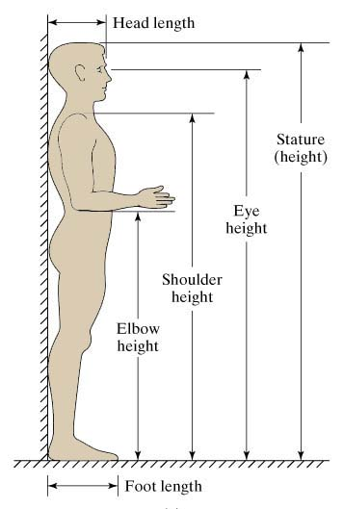
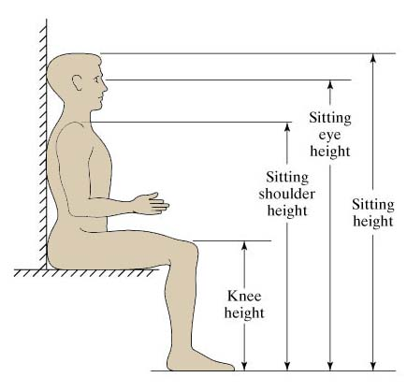
Static Dimensions of Human Body
Standing
Seated
Work Systems and the Methods, Measurement, and Management of Work
by Mikell P. Groover, ISBN 0-13-140650-7.
©2007 Pearson Education, Inc., Upper Saddle River, NJ. All rights reserved.

Slide 7
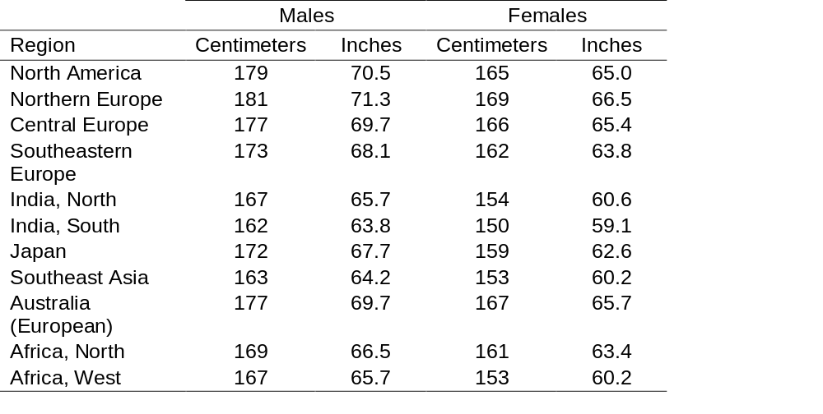
Standing Heights of Males and Females throughout the World
Work Systems and the Methods, Measurement, and Management of Work
by Mikell P. Groover, ISBN 0-13-140650-7.
©2007 Pearson Education, Inc., Upper Saddle River, NJ. All rights reserved.

Slide 8
Anthropometric Data
Anthropometric data for a homogeneous population usually obeys normal distribution
Published data indicate not only mean values but also some measure of dispersion
  Percentile limits on the variable
    5th and 95th percentile points common
  Standard deviation
    Applies to specific anthropometric variable
Work Systems and the Methods, Measurement, and Management of Work
by Mikell P. Groover, ISBN 0-13-140650-7.
©2007 Pearson Education, Inc., Upper Saddle River, NJ. All rights reserved.

Slide 9
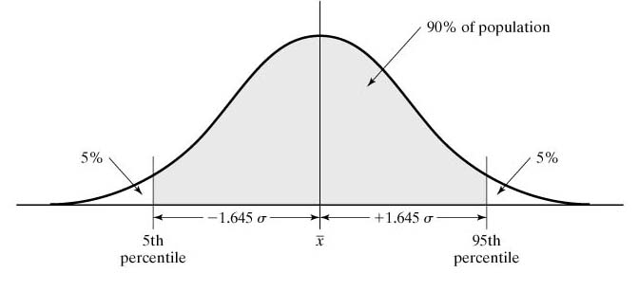
Normal Distribution in Anthropometry
Normal distribution for a given anthropometric variable of interest
Work Systems and the Methods, Measurement, and Management of Work
by Mikell P. Groover, ISBN 0-13-140650-7.
©2007 Pearson Education, Inc., Upper Saddle River, NJ. All rights reserved.

Slide 10
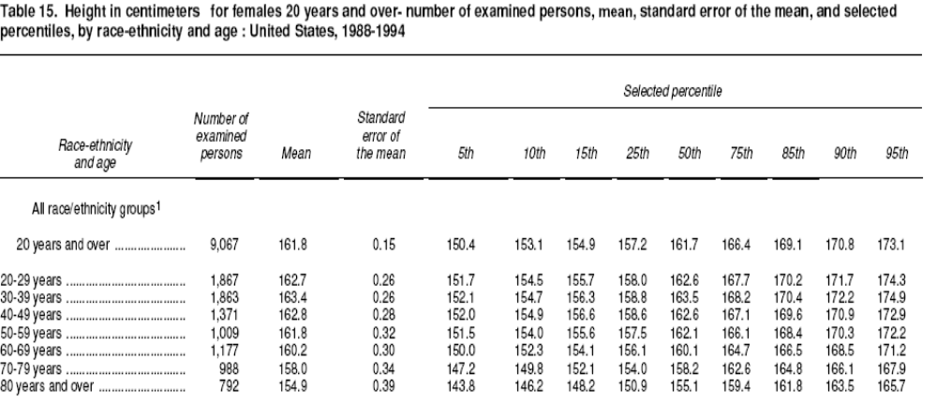
Work Systems and the Methods, Measurement, and Management of Work
by Mikell P. Groover, ISBN 0-13-140650-7.
©2007 Pearson Education, Inc., Upper Saddle River, NJ. All rights reserved.

Slide 11
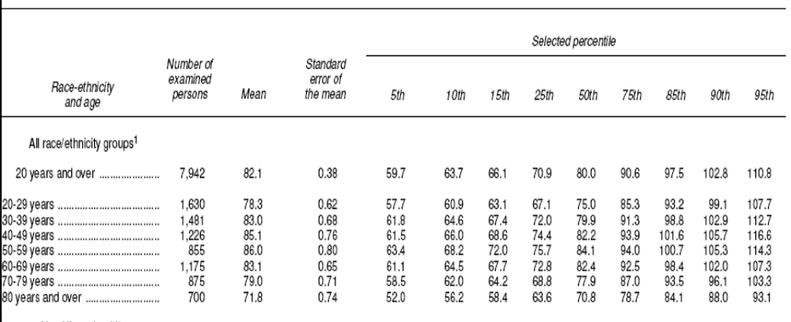
Work Systems and the Methods, Measurement, and Management of Work
by Mikell P. Groover, ISBN 0-13-140650-7.
©2007 Pearson Education, Inc., Upper Saddle River, NJ. All rights reserved.

Slide 12
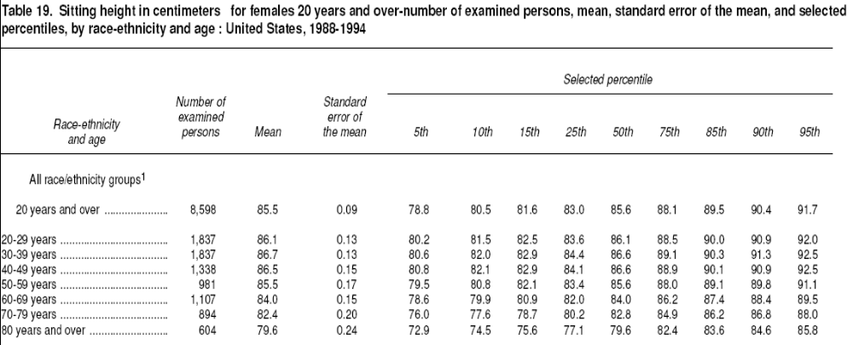
Work Systems and the Methods, Measurement, and Management of Work
by Mikell P. Groover, ISBN 0-13-140650-7.
©2007 Pearson Education, Inc., Upper Saddle River, NJ. All rights reserved.

Slide 13
Anthropometric Design Principles
Design for extreme individuals
Design for adjustability
Design for the average user
Design different sizes for different size users
Work Systems and the Methods, Measurement, and Management of Work
by Mikell P. Groover, ISBN 0-13-140650-7.
©2007 Pearson Education, Inc., Upper Saddle River, NJ. All rights reserved.

Slide 14
Design for Extreme Individuals
Designing for the maximum (95th percentile)
  Doorway heights
  Automobile door openings
  Mattress sizes
Designing for the minimum (5th percentile)
  Heights of kitchen cabinets
  Locations of levers and dials on equipment
  Weights of portable power tools
Work Systems and the Methods, Measurement, and Management of Work
by Mikell P. Groover, ISBN 0-13-140650-7.
©2007 Pearson Education, Inc., Upper Saddle River, NJ. All rights reserved.

Slide 15
Design for Adjustability
To accommodate a wide range of users
Examples:
  Automobile driver seats
  Adjustable steering wheel in an automobile
  Office chairs
  Worktable heights
  Tilt angles of computer monitors
  Lawnmower handle heights
  Bicycle handlebars
Work Systems and the Methods, Measurement, and Management of Work
by Mikell P. Groover, ISBN 0-13-140650-7.
©2007 Pearson Education, Inc., Upper Saddle River, NJ. All rights reserved.

Slide 16
Design for Average User
For situations in which design for extreme individuals and adjustability are not feasible
Design for 50 th percentile
Examples:
  Stair heights
  Stadium seats
  Sofas
  Heights of checkout counters at supermarkets
  Lengths of shovel handles
Work Systems and the Methods, Measurement, and Management of Work
by Mikell P. Groover, ISBN 0-13-140650-7.
©2007 Pearson Education, Inc., Upper Saddle River, NJ. All rights reserved.

Slide 17
Different Sizes for Different Size Users
When the only way to accommodate user population is to make the product in different sizes
Examples:
  Clothing
  Shoes
  Elementary school desks and chairs
Work Systems and the Methods, Measurement, and Management of Work
by Mikell P. Groover, ISBN 0-13-140650-7.
©2007 Pearson Education, Inc., Upper Saddle River, NJ. All rights reserved.

Slide 18
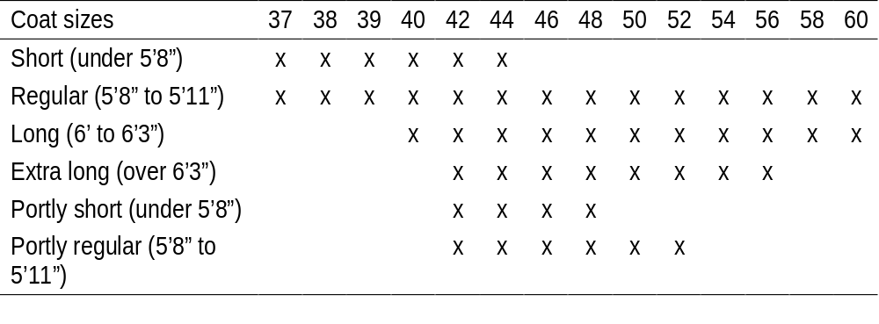
Different Sizes for Different Size Users
Example: Men’s suit coat sizes available from mail-order clothing store
Work Systems and the Methods, Measurement, and Management of Work
by Mikell P. Groover, ISBN 0-13-140650-7.
©2007 Pearson Education, Inc., Upper Saddle River, NJ. All rights reserved.

